Slide 1
CSE 10124
Text as Data

Slide 2
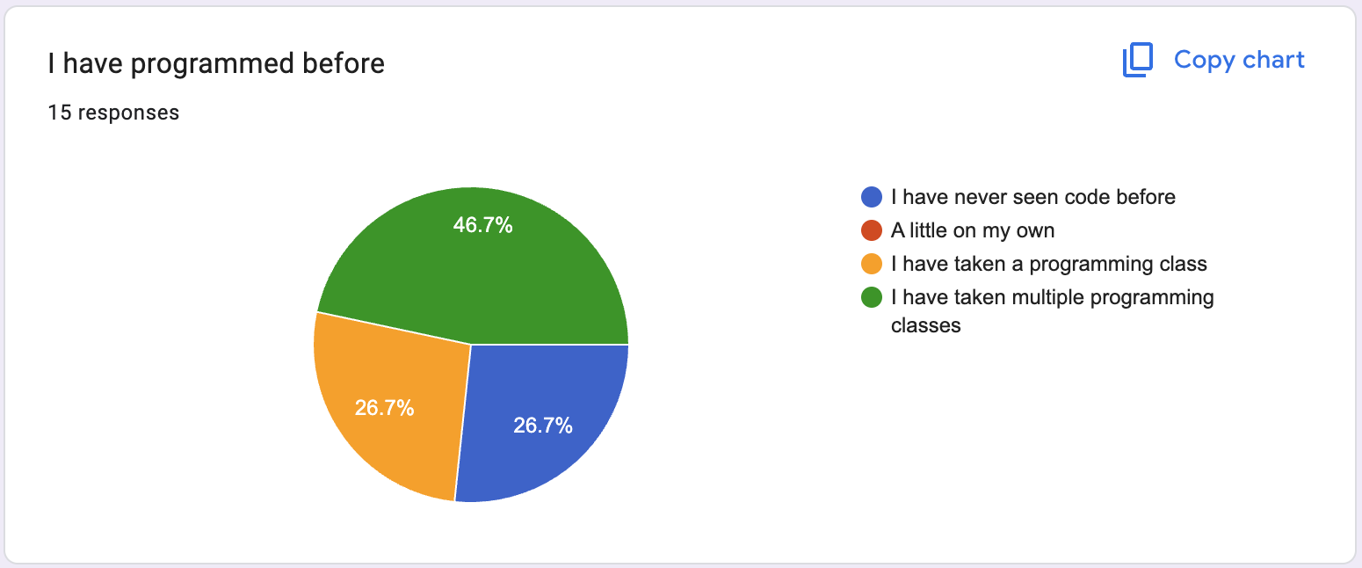
Intro Survey Results
For those of you new to programming, be humble enough to ask questions!
For those of you that are coding prodigies, think and ask about the algorithms!

Slide 3
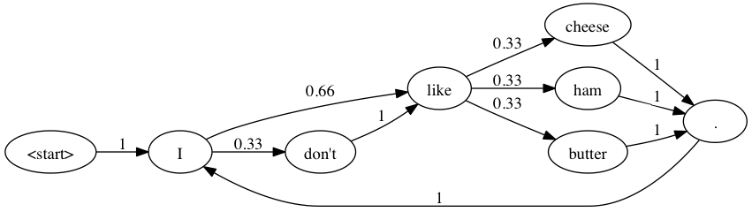
Last Class
Markov Babbler

Slide 4
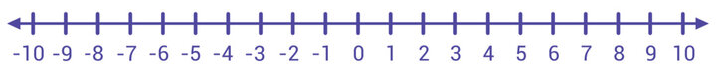
Introduction to Markov Processes
A systematic method for generating a sequence of random variables where the current value is probabilistically dependent on the value of the prior variable
Specifically, selecting the next variable is dependent upon _______________________

Slide 5
Markovian Terms
The changes of state of the system are called ____________ and the probabilities associated are called _______________________
The process is characterized by:
_____________________
_____________________
_____________________

Slide 6
Markov Chains
Notes:
Have students introduce themselves, then TAs, and then instructor

Slide 7
Markov Babbler
“<SOS> And yet I got ganked while questing. <EOS>”

Slide 8

Creating our Graph
jabberwocky.txt
"Jabberwocky"
by Lewis Carroll
'Twas brillig, and the slithy toves
Did gyre and gimble in the wabe;
All mimsy were the borogoves,
And the mome raths outgrabe.
"Beware the Jabberwock, my son!
The jaws that bite, the claws that catch!
Beware the Jubjub bird, and shun
The frumious Bandersnatch!"
He took his vorpal sword in hand:
Long time the manxome foe he sought—
So rested he by the Tumtum tree,
And stood awhile in thought.

Slide 9
Creating our Graph
shakespeare.txt
From fairest creatures we desire increase,
That thereby beauty's rose might never die,
But as the riper should by time decease,
His tender heir might bear his memory:
But thou contracted to thine own bright eyes,
Feed'st thy light's flame with self-substantial fuel,
Making a famine where abundance lies,
Thy self thy foe, to thy sweet self too cruel:

Slide 10
Differences

Slide 11
Statistical Distributions
A statistical distribution describes the ______________________________
One way you can think about what AI is doing is it’s trying to learn distributions

Slide 12
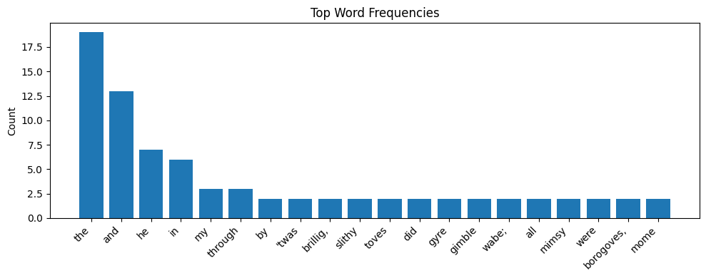

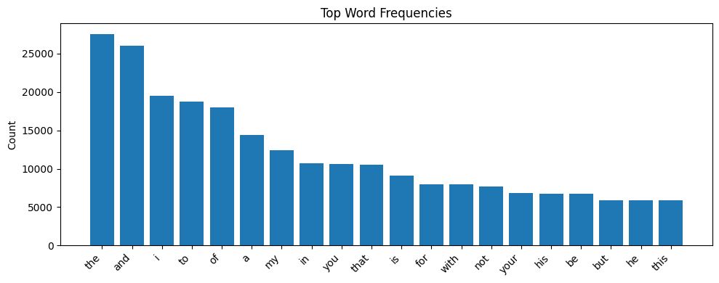

jabberwocky.txt vs. shakespeare.txt

Slide 13
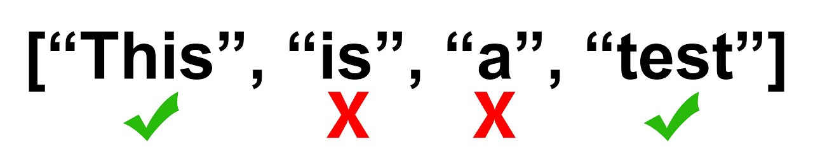
Stop Words
Stop words are common, high-frequency words that often carry little specific meaning and are filtered out in Natural Language Processing (NLP) systems

Slide 14
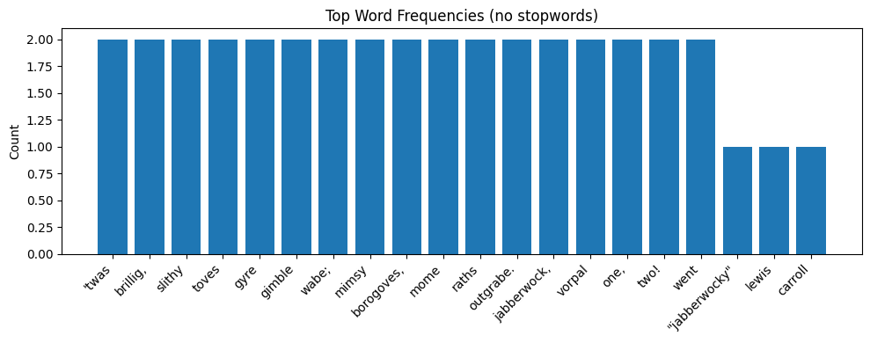
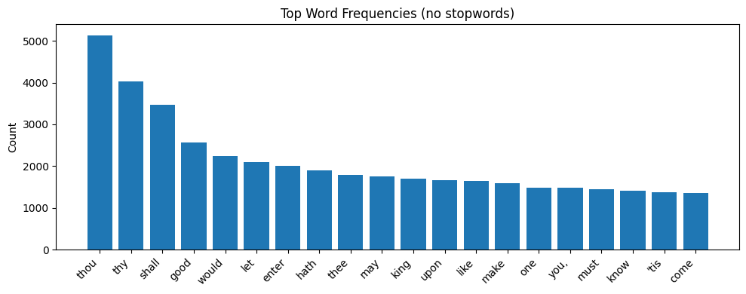
jabberwocky.txt vs. shakespeare.txt

Slide 15
Sampling Distributions and Generative AI
“Generative artificial intelligence is a subset of artificial intelligence that uses generative models to produce text, images, videos, or other forms of data. These models learn the underlying patterns and structures of their training data and use them to produce new data” — Wikipedia

Slide 16

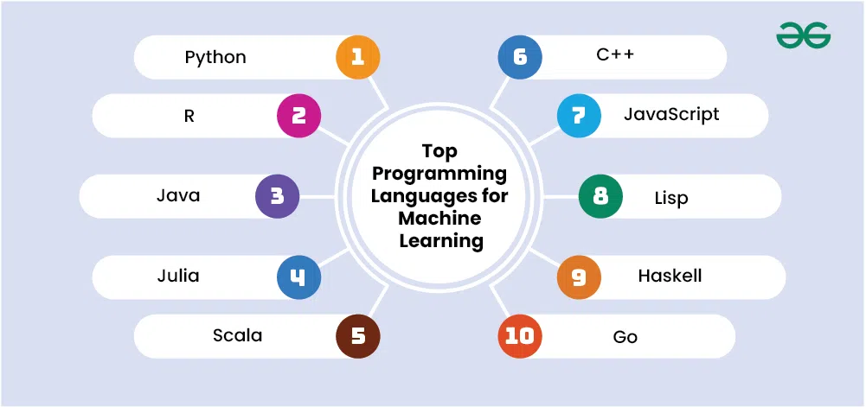
Programming in Python

Slide 17
Python Programming
A Crash Course

Slide 18
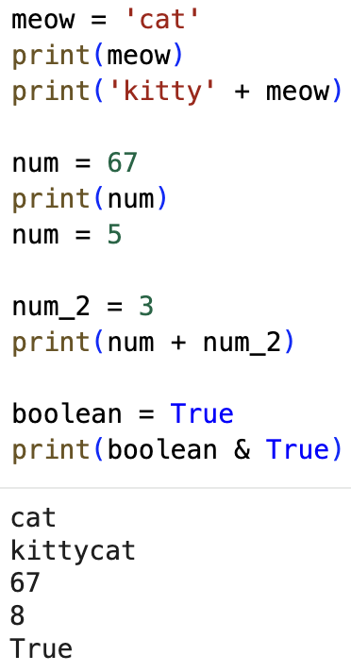
Variables
Variables allow us to store data using a convenient name.

Slide 19
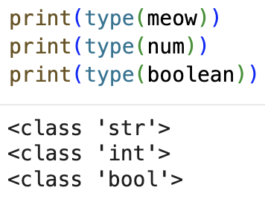
Types
Variables have a type:
int (a whole number)
str (a “string”)
bool (true or false)
and many others!

Slide 20
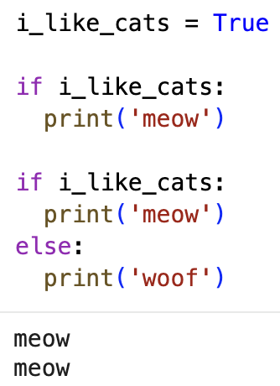
Conditionals
Often times we want to check the value of a variable, and do different things depending on what it is. The most common conditional is the if statement

Slide 21
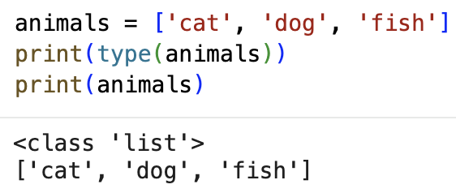
Data Structures
In addition to basic things like str and int, we can store more complex things called data structures that may allow us to store multiple values in a variable
The simplest data structures is called a list

Slide 22
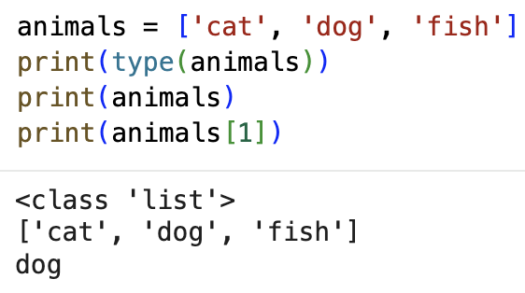
Lists
lists can hold just about anything you would want, even other lists!
We can access specific items using square brackets and an “index”
NOTE: the first item in a list is index 0, NOT 1!

Slide 23
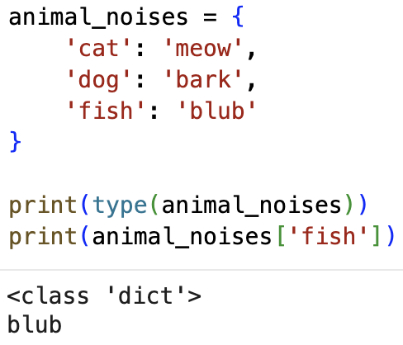
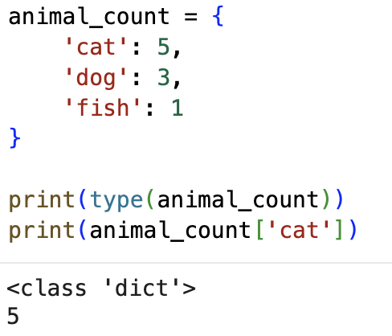
Dictionaries
Dictionaries store groups of two things, called: “key - value pairs”. To access items in a dictionary we use square brackets again, but with a value in the brackets instead of an index

Slide 24
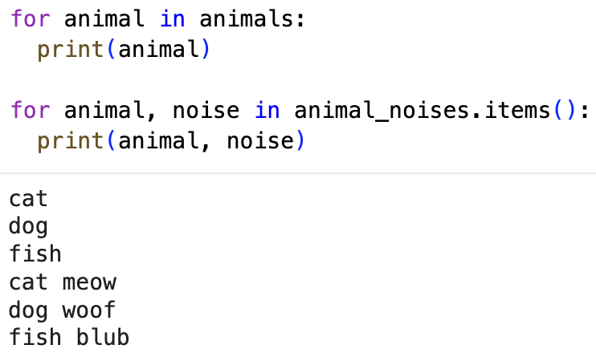
Loops
When we have a data structure, we often want to loop over it. The most common loop is the for loop

Slide 25
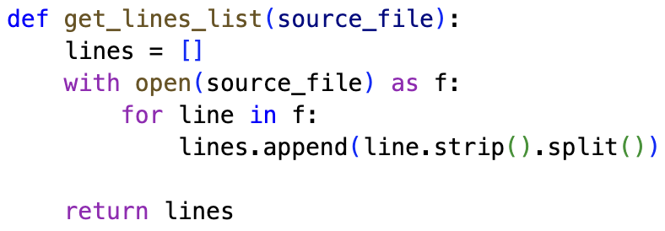
Functions
Often times we will want to run the same set of instructions on different variables, we can define a function to achieve this

Slide 26
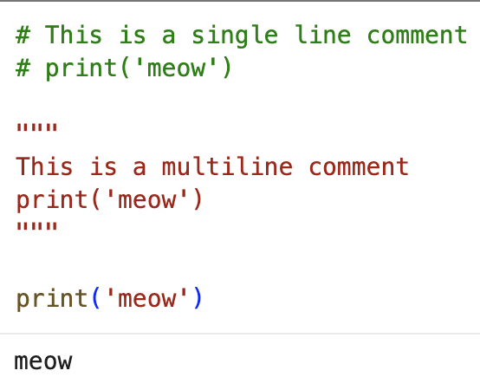
Comments
Oftentimes while programming you will want to leave explanatory text in the code, these are called comments. In python we do this with either a pound symbol: # if the comment is a single line, or triple quotes: “”” if the comment is multiline

Slide 27
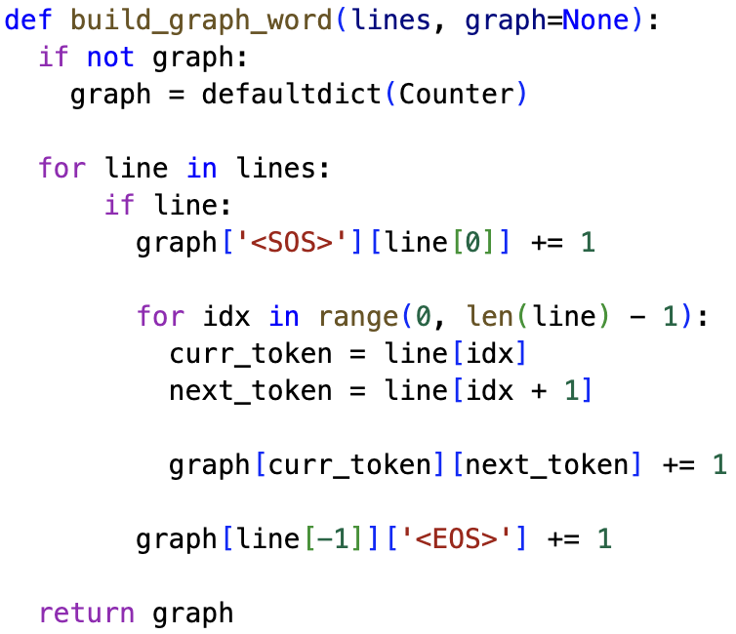
Creating our Graph: Code

Slide 28
<SOS> and <EOS>
<SOS> — Start of Sequence
<EOS> — End of Sequence
These are special tokens often seen when working with text, another one is:
<UNK> — Unknown
<UNK> is used to represent words that we haven’t seen in our vocab before

Slide 29
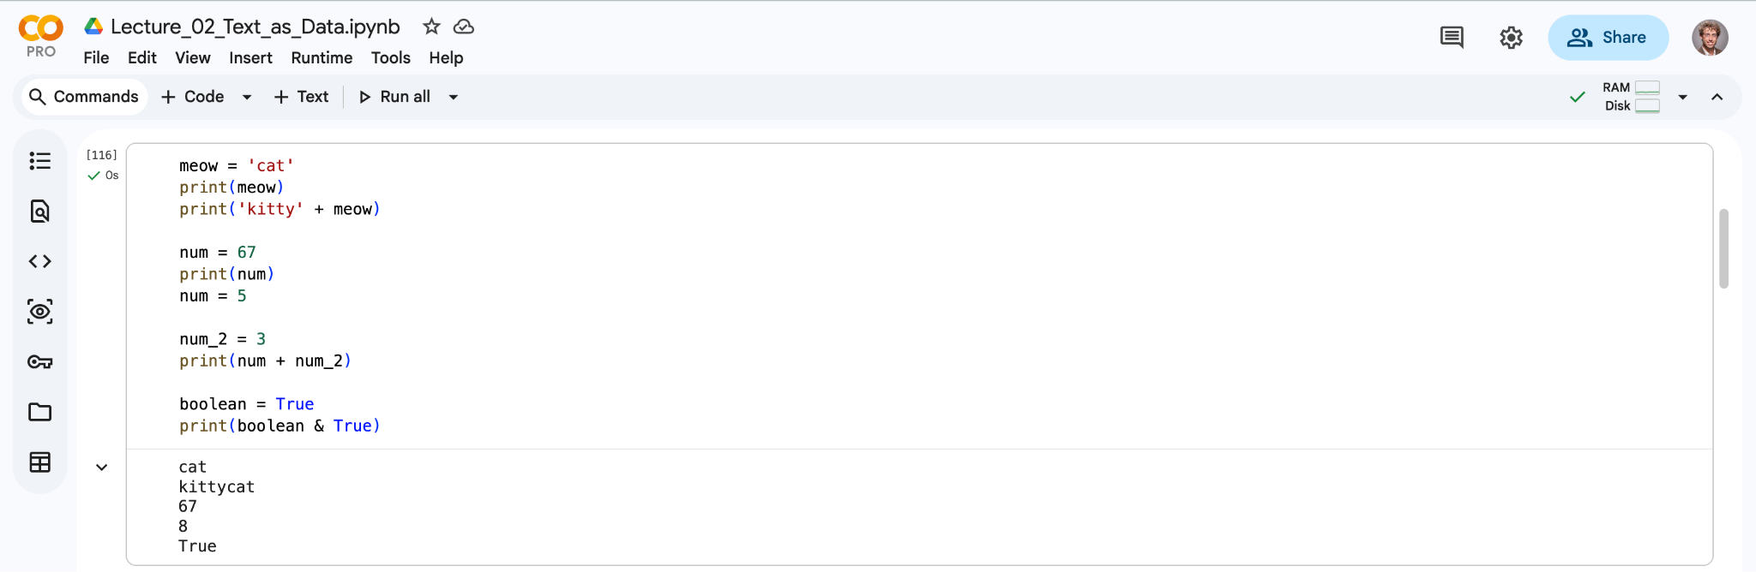
Google Colab
Google Colab lets you run python code in your online and integrates with your Google Drive! This is primarily what we’ll be using in this class.

Slide 30
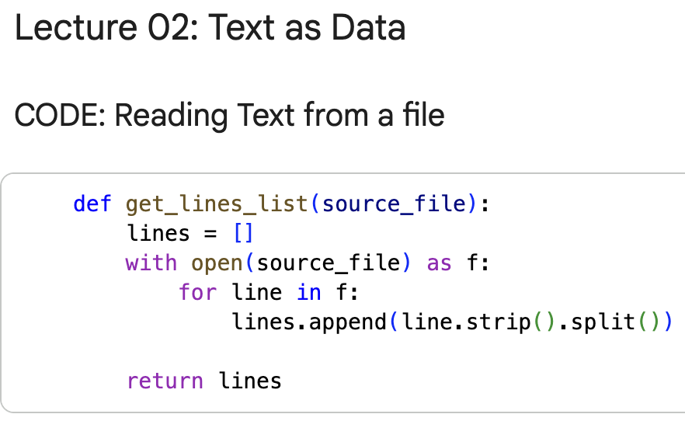
.ipynb Files
We’re going to use a type of file called a notebook
These let you put text and code alongside each other and can display graphs from your code right away. Most data scientists and AI researchers use notebooks every day.

Slide 31
Our First Notebook
Let's open our notebook for today’s lecture and get started!
Notebook

Slide 32
Generating Text from our Graph
We can generate new sentences from our model by providing it with a “prompt” to get started and then letting it probabilistically travel through the graph.

Slide 33
Character-Level Graph
jabberwocky.txt
"Jabberwocky"
by Lewis Carroll
'Twas brillig, and the slithy toves
Did gyre and gimble in the wabe;
All mimsy were the borogoves,
And the mome raths outgrabe.
"Beware the Jabberwock, my son!
The jaws that bite, the claws that catch!
Beware the Jubjub bird, and shun
The frumious Bandersnatch!"
He took his vorpal sword in hand:
Long time the manxome foe he sought—
So rested he by the Tumtum tree,
And stood awhile in thought.

